Slide 1

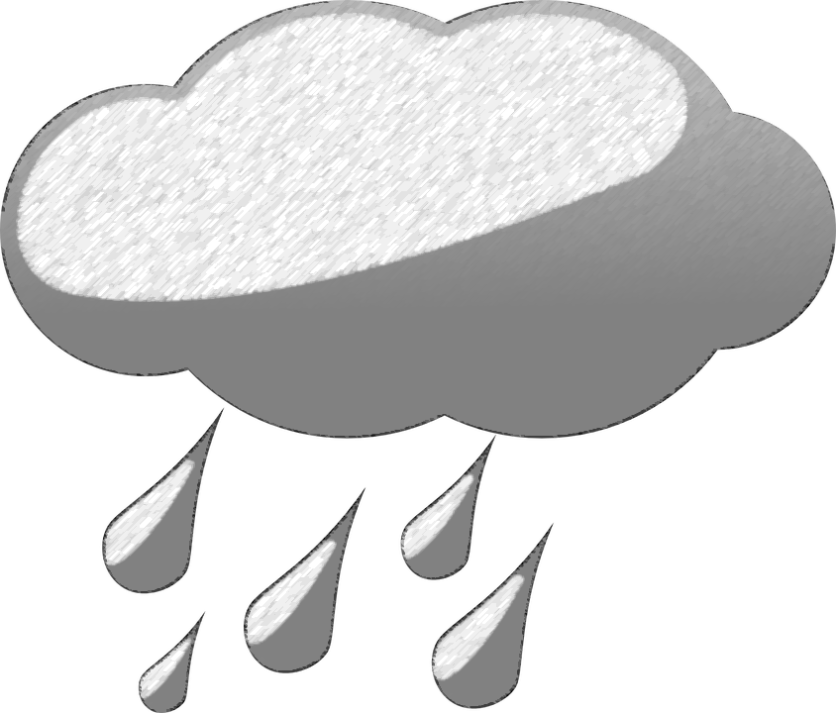

Motor Vehicle Accidents per emergency Call Data
Pete Way, Jeremy Roland, Dr. Mina Sartipi
SCAL Research
Notes:
<number>

Slide 2
Project Overview
Hamilton County 911 Accident Call Reports
KCHA Lovell Field Station Weather Reports
Goal: To find a correlation between injuries sustained from vehicular accidents and weather occurrences.
Notes:
This is a smart transport project
Has currently been in development for around 1 month
Covers descriptive analysis of weather data and 911 call log data
Overview:
We received records from the Hamilton County 911 Emergency Center, and weather reports from KCHA Lovell Field Airport Station
Goal: Discover correlations between injuries that resulted from reported vehicular accidents and weather occurrences
<number>

Slide 3

Original Report Entries Become features
Weather Reports:
Date/Time
Temperature
Dewpoint
Humidity
Wind Speed
Wind Gust Speed
Wind Direction
Wind Direction in Degrees
Pressure
Weather Event (22 → 4)
Cloudy, Foggy, Rainy, Rainstorm
911 Reports:
Date/Time of Response
Date/Time of Resolution
Address
City
Latitude/Longitude
Problem
Notes:
Blue represents currently used factors, with green being for future phases
Originally, we got a mass amount of data from the two sources
The two data sets were separate, so we combined them into a single data source by time and date.
Once the data had been matched accordingly, we had to format the variables into a style that was acceptable for Logistic Regression to be performed
We began by creating dummy values for each of the variables
Then, we aggregated the dummy values
All weather data was aggregated based on general attributes (light rain, rain, heavy rain, and drizzle became rainy)
This reduced our total number of features from 22 to 4
We also dropped redundant data like specific wind direction (N, NE, S, SW)
These were already represented by the Wind Direction in Degrees category
Through testing, we determined to drop more features, including Wind Direction in Degrees, Wind Speed, Clear, Pressure, Wind Gust Speed
Currently, we are running our tests using 9 features
<number>

Slide 4
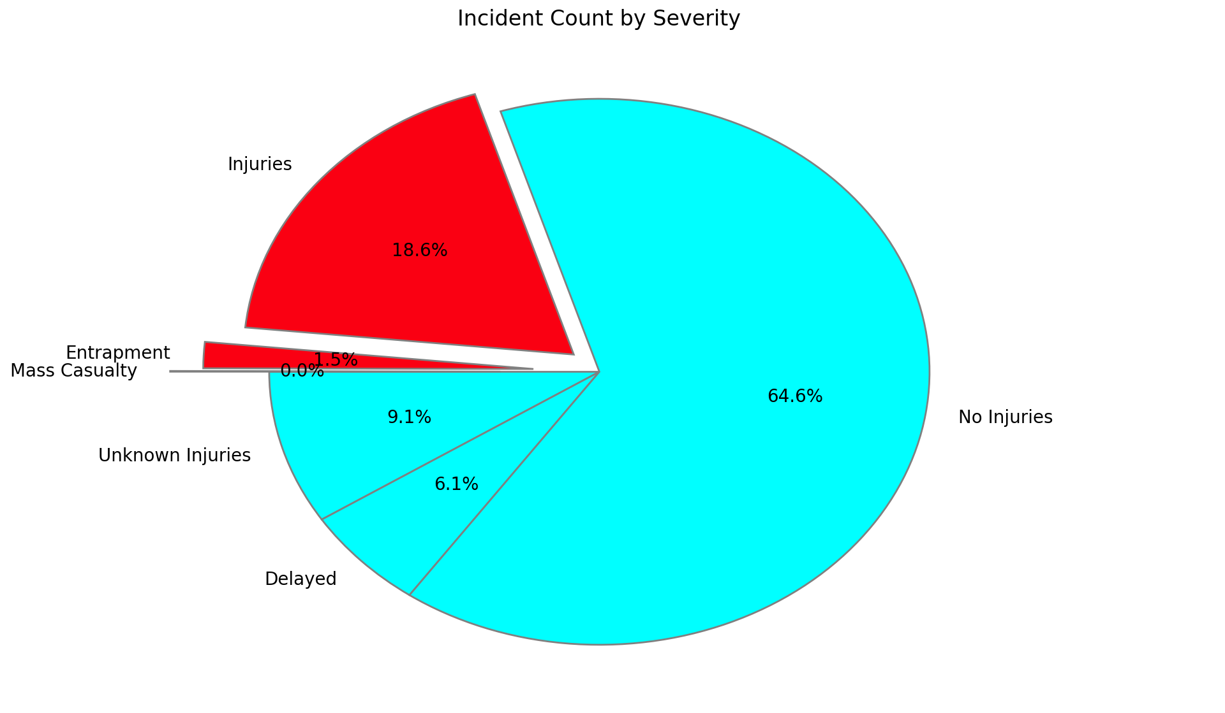
Division of Calls per Type of Incident
Injuries:
Injuries
Entrapment
Mass Causality
No Injuries:
No Injuries
Unknown Injuries
Delayed
Notes:
All accidents that resulted in an injury were aggregated into the Injury category, while the remaining were deemed no injury. Injury accounts for roughly 20 percent of the total accidents.
<number>

Slide 5
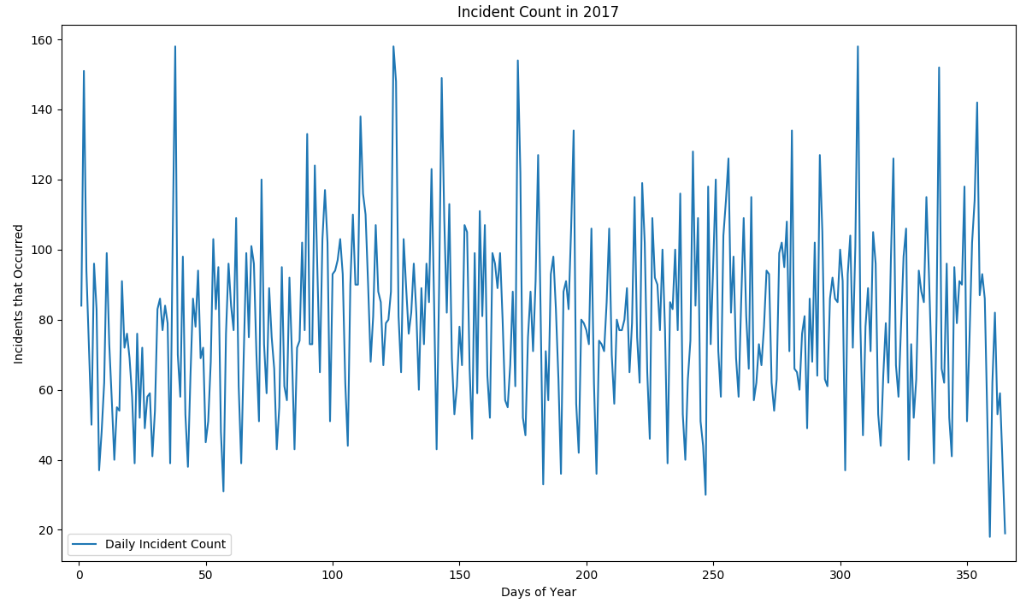
Division of Daily Calls Throughout 2017
Notes:
For the Accidents per Day in 2017 Graph:
Mention high and low points
High points: took place around Thanksgiving and Christmas, with 3 significantly high spikes in the last 60 days of the year
Low points:
Day 359: Christmas Day itself
Day 365 (New Years Eve): Dec 31st
Day 247: Sep 4th (Labor Day)
<number>

Slide 6
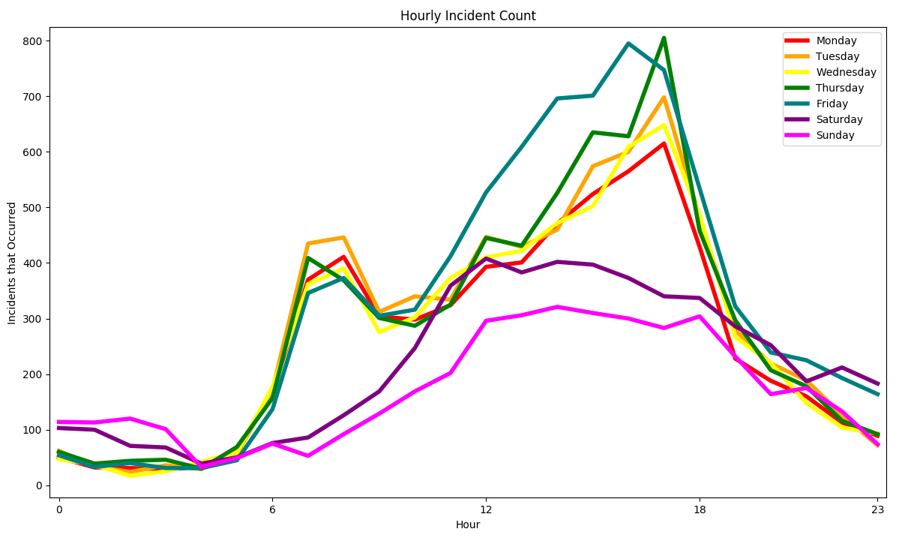
Average Division of Hourly Calls By Day
Notes:
Note, workweek versus weekend totals.
Weekend is much lower overall, but near midnight on both Saturday and Sunday are markedly higher than weekdays. Also, see that Friday’s rush hour occurs roughly an hour before the rest of the workweek. (Perhaps individuals leaving work early for a long weekend?)
<number>

Slide 7
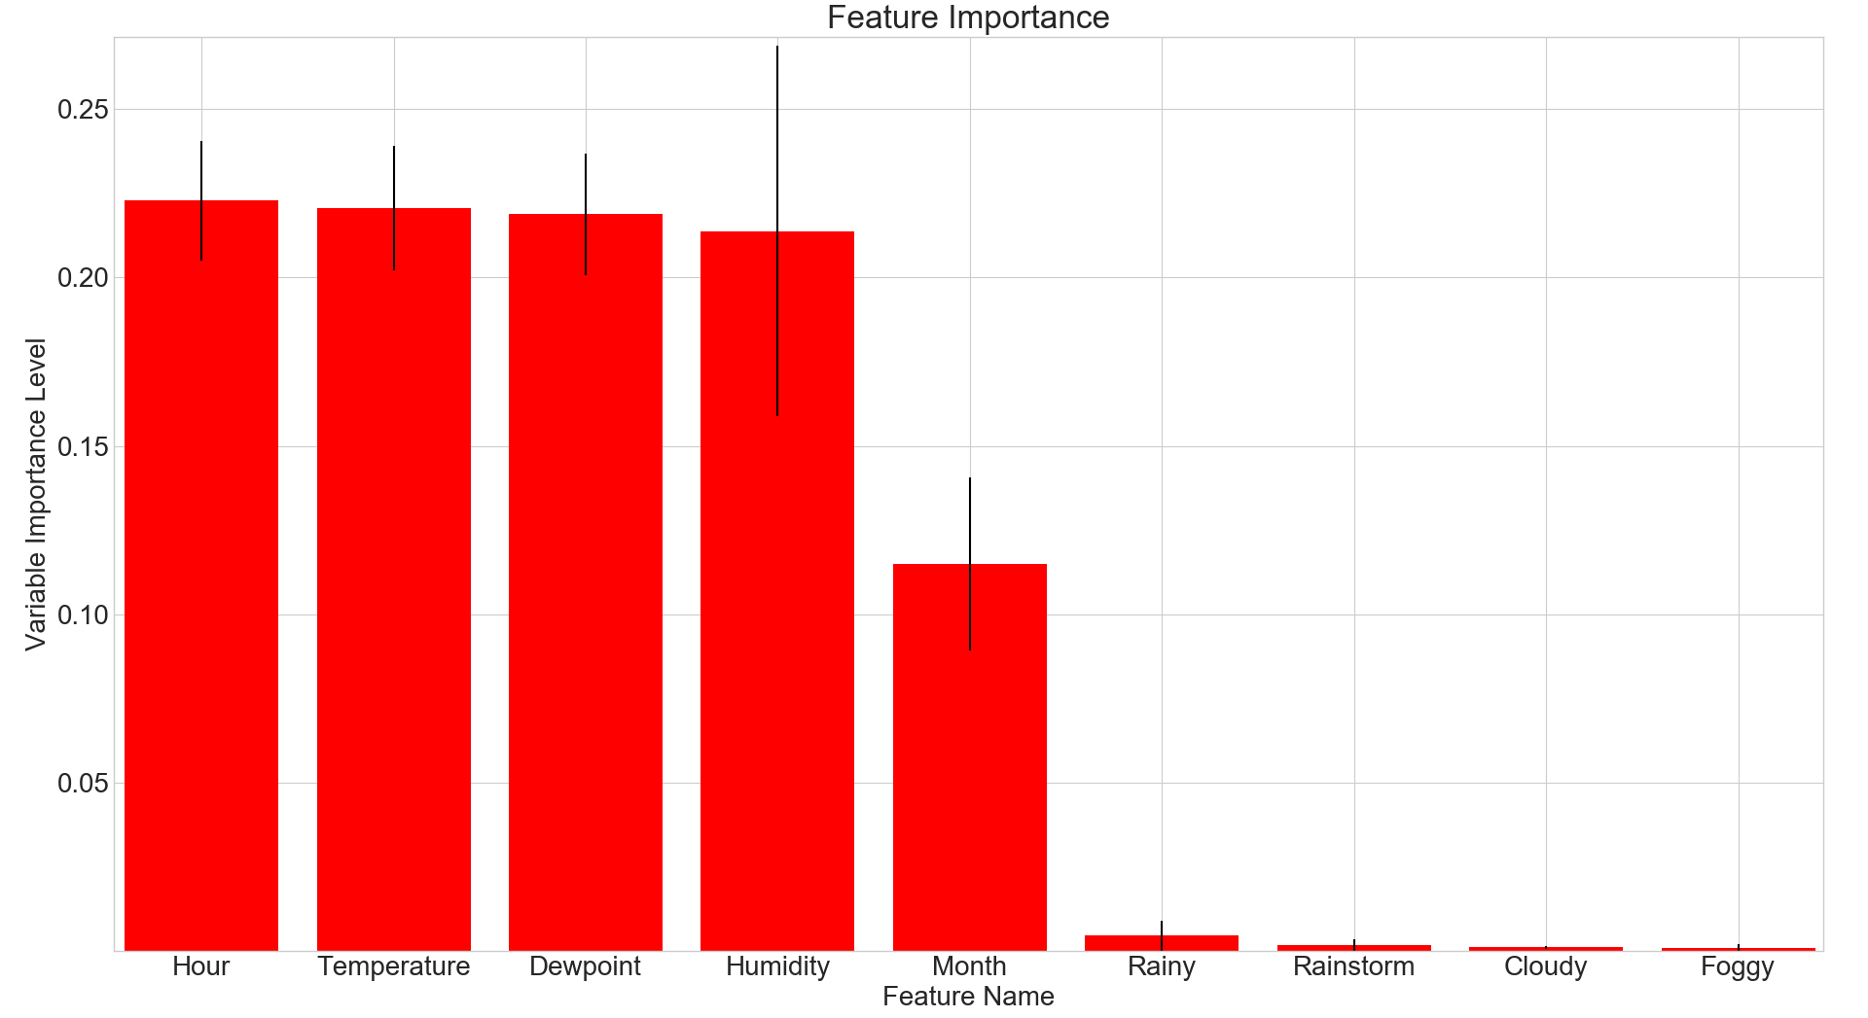
Variable Importance – All features
Notes:
Black line indicates standard deviation. (SD is the dispersion range of the feature, so Humidity has the most range since humidity is represented as a percent of a whole)
<number>

Slide 8
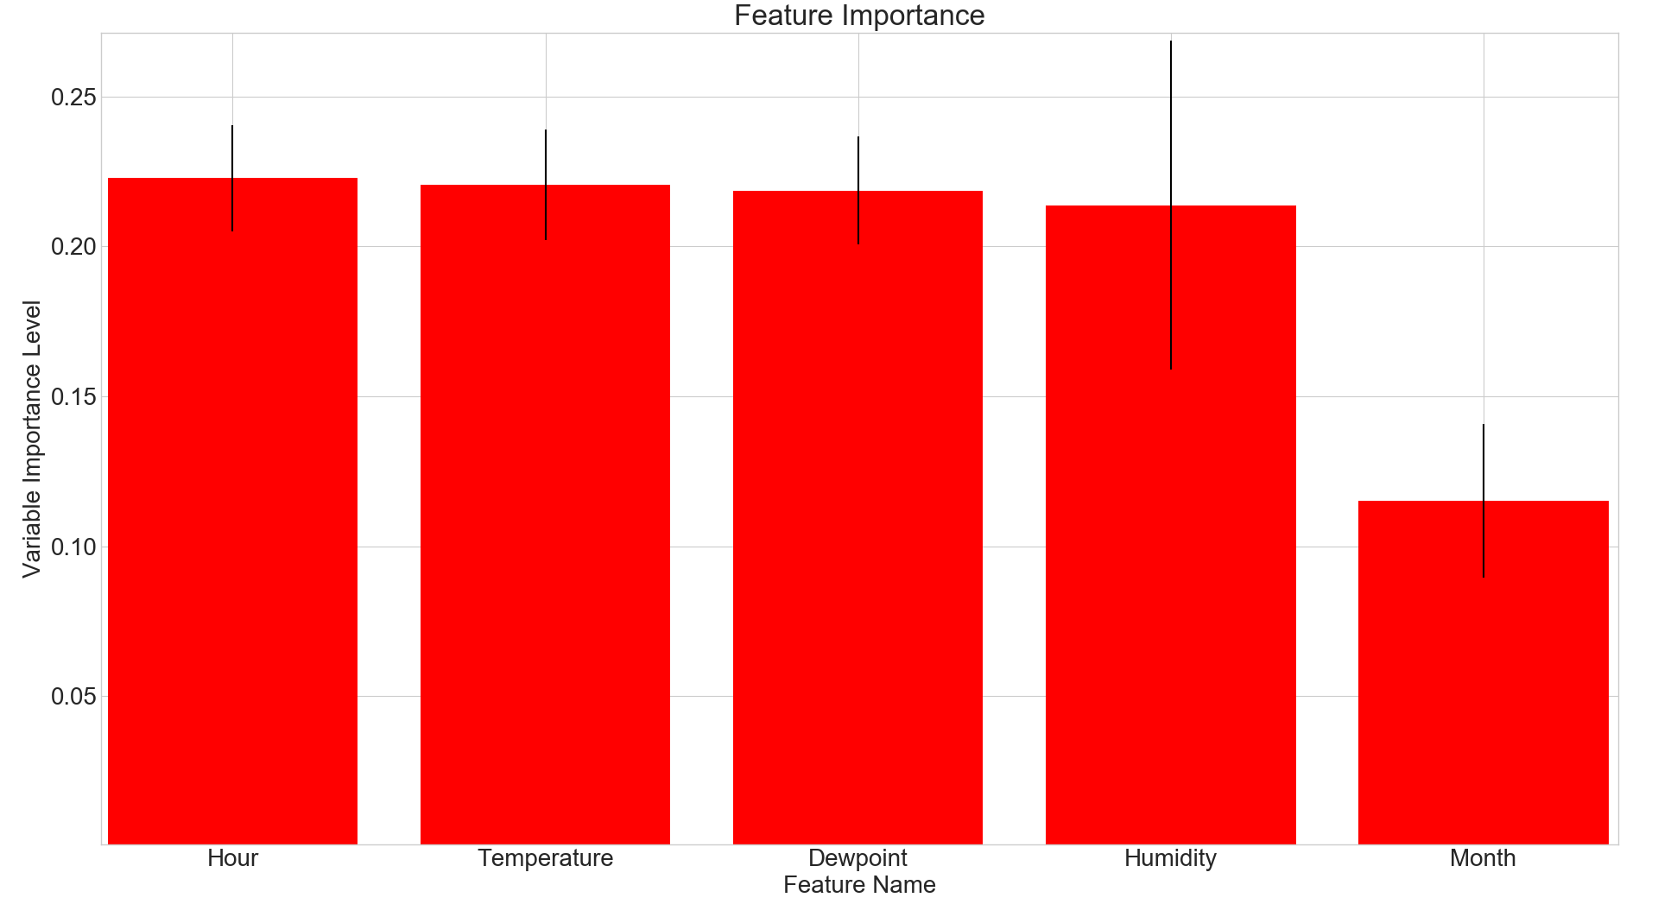
top 5 Variables of Importance
Notes:
<number>

Slide 9
Adjusted and Unadjusted P-values and Odds
 | UnAdjusted P | Adjusted P
Intercept | 0.000 | 0.000
Hour | 0.001 | 0.001
Temperature | 0.000 | 0.000
Dewpoint | 0.000 | 0.000
Humidity | 0.000 | 0.000
Wind Speed | 0.076 | /
Wind Gust Speed | 0.012 | /
Wind Direction Degrees | 0.095 | /
Pressure | 0.871 | /
Weekday | 0.297 | /
Month | 0.001 | 0.000
Clear | 0.911 | /
Rainy | 0.177 | 0.000
Rainstorm | 0.000 | 0.000
Cloudy | 0.117 | 0.000
Foggy | 0.055 | 0.001
 | UnAdjusted Odds | Adjusted Odds
Hour | 1.0107 | 1.099
Temperature | 1.0372 | 1.03464
Dewpoint | 0.9656 | 0.9681
Humidity | 1.0132 | 1.0129
Wind Speed | 0.9951 | /
Wind Gust Speed | 1.0041 | /
Wind Direction Degrees | 0.9998 | /
Pressure | 1.0001 | /
Weekday | 1.0083 | /
Month | 0.9846 | 0.9829
Clear | 0.977 | /
Rainy | 0.757 | 0.7561
Rainstorm | 0.3787 | 0.3827
Cloudy | 0.7265 | 0.7344
Foggy | 0.6447 | 0.6727
Notes:
P Value = Variables are considered significant if their p-value is below the significance level, which for us was 0.05. Note: After removing 6 features, all p-values fell below the significance threshold
Odds = How likely it is that the feature will cause the accident to have injuries. Above 1 means the injury is more likely to cause an injury, below 1 means less likely to cause an injury
<number>

Slide 10
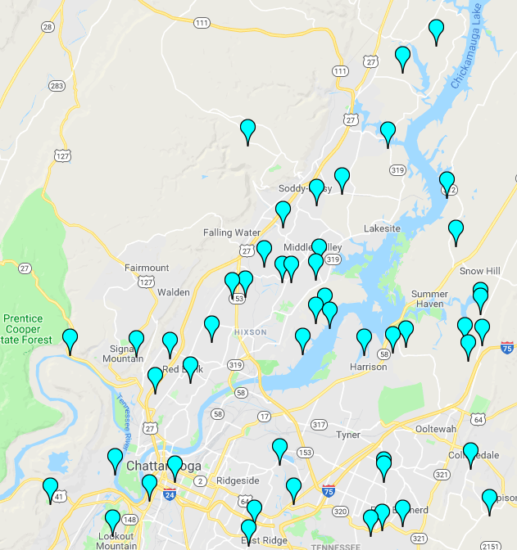
Future Phases of research
Next phases of research to include:
51 local area weather stations to provide more accurate reports for each 911 report
Implement geolocation using Latitude, Longitude
and specific addresses
Track most frequent accident hotspots
Compare such hotspots to notorious roadways
Enhance feature accuracy by integrating TITAN crash field notes alongside 911 reports
Weather Station Map
Map
Accident Heatmap
Notes:
<number>

Slide 11
Future Phases of research
TITAN Features of Interest:
Roadway name
County
Time of Crash
Time Notified
Time Arrived
Date of Crash
Speed Limit
Weather
Light condition
Driver Seatbelt / Airbag / Deployed / Injured
Vehicle Year / Type / Model
Owner/Driver Status
Passenger Seatbelt / Airbag / Deployed / Injured
Passenger Status / Seating Position
Notes:
<number>

Slide 12


Thank you
Notes:
<number>

